Slide 1
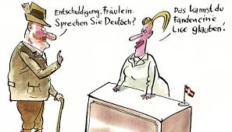
German resource room (GRR)
Dynamic archives for German Studies, E-playground and German Practice Area

Slide 2
Purpose
The Resource Room's foremost goal is to support students on their way through their studies It contains professional support of lasting value; to a lesser extent topical things and social functions
Notes:
På ruspjecen, som I alle sammen har fået udleveret, har der sneget sig en lille deklinationsfejl ind. Det kan ske for selv den bedste, men citatet, som Immanuel Kant har gjort bevinget, hedder rettelig Habe Mut, dich deines eigenen Verstandes zu bedienen. Citatet er velvalgt, synes jeg. Men hvis vi justerer det en anelse, som I kan se i overskriften, bliver citatet endnu mere relevant for det, der foregår her på universitetet. I skal ikke bare have forstand, I skal have faglig forstand.
Tysk Ressourcerum er et virtuelt sted på intranettet Absalon, der gerne vil hjælpe jer med at nå det mål.

Slide 3
Purpose of the German resource room
Overview and relations Practice and feedback Encouragement and motivation Metacommunication Sharing knowledge, discoveries and experiences Collection of templates, models, links and summaries
Memory function of German Studies

Slide 4
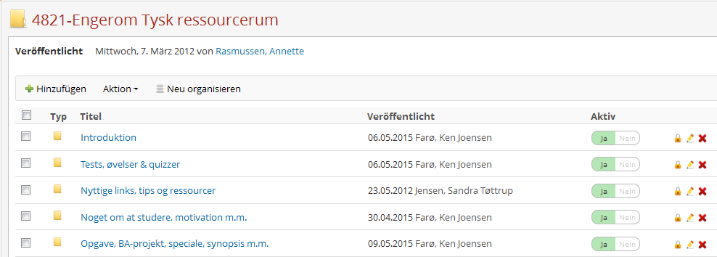
Presentation of content - 5 folders

Slide 5
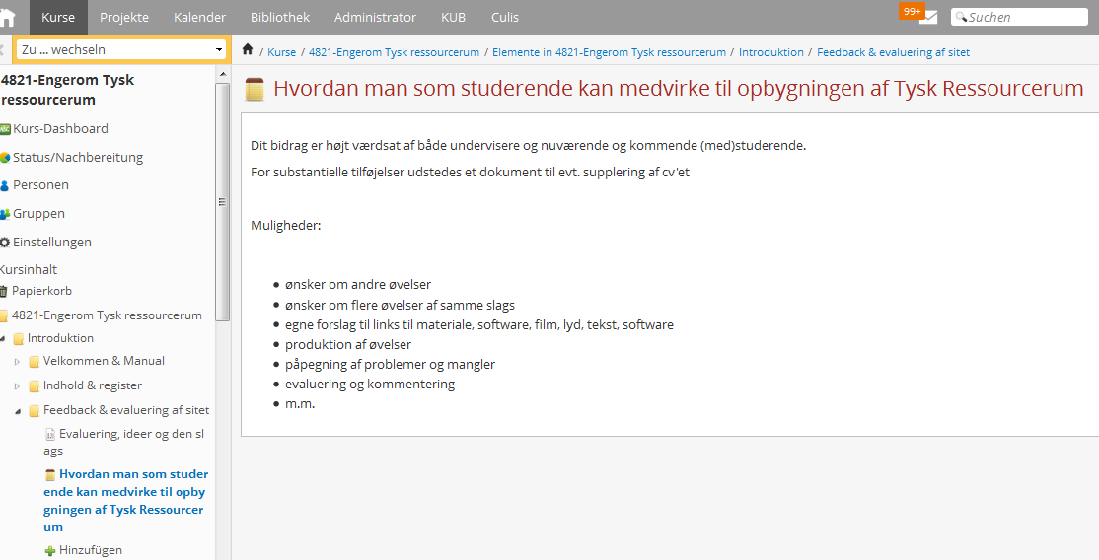
Feedback & evaluation of the side

Slide 6
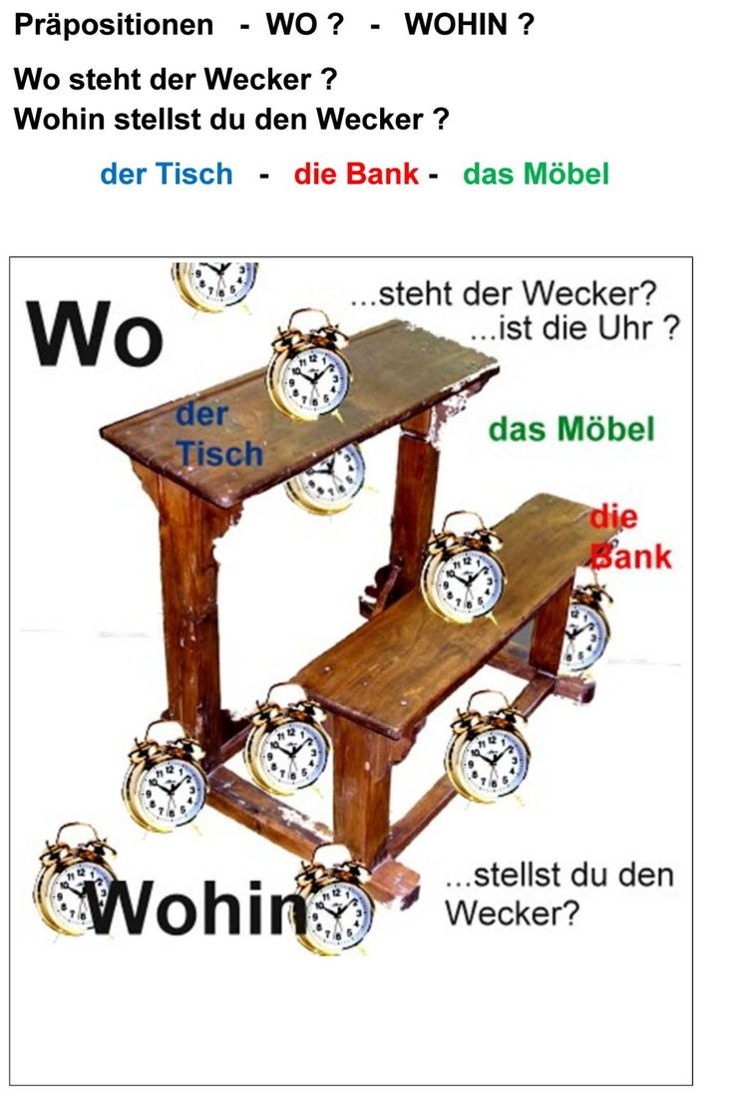
2. Exercises, tests and quizzes
- Proficiency exercises - Knowledge exercises - Translation exercises - Analytical exercises - Contrastive exercises

Slide 7
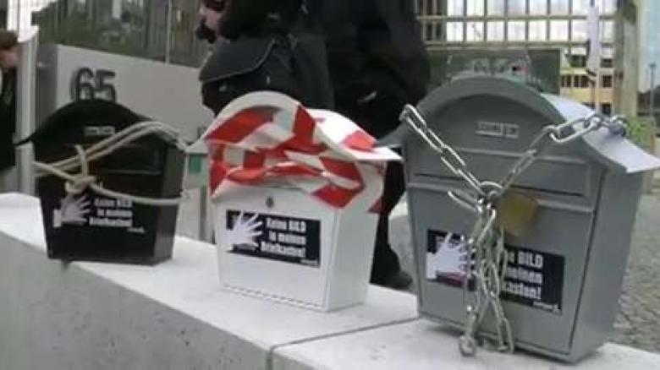
Proficiency. Example: Listening-comprehension
Listen and take notes
Answer the comprehension question
Make audio dictation of 0:16 - 1:07
Translate given passages
Notes:
[AFSPIL VIDEO]

Slide 8
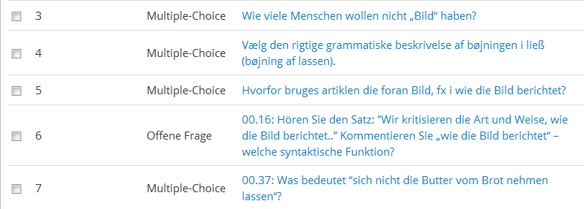
Comprehension-questions : Audio dictation

Slide 9
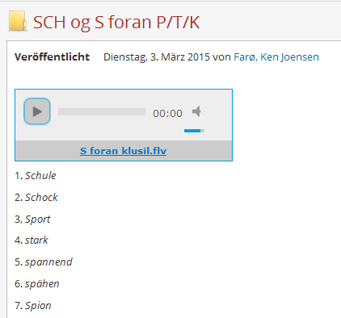
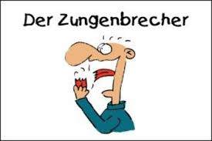
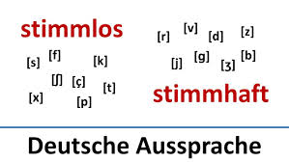
Language proficiency exercises Example: Pronunciation

Slide 10
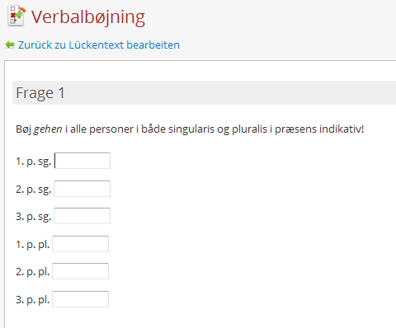
Language proficiency exercises Example: Grammatical and other linguistic exercises with auto-feedback (1)

Slide 11
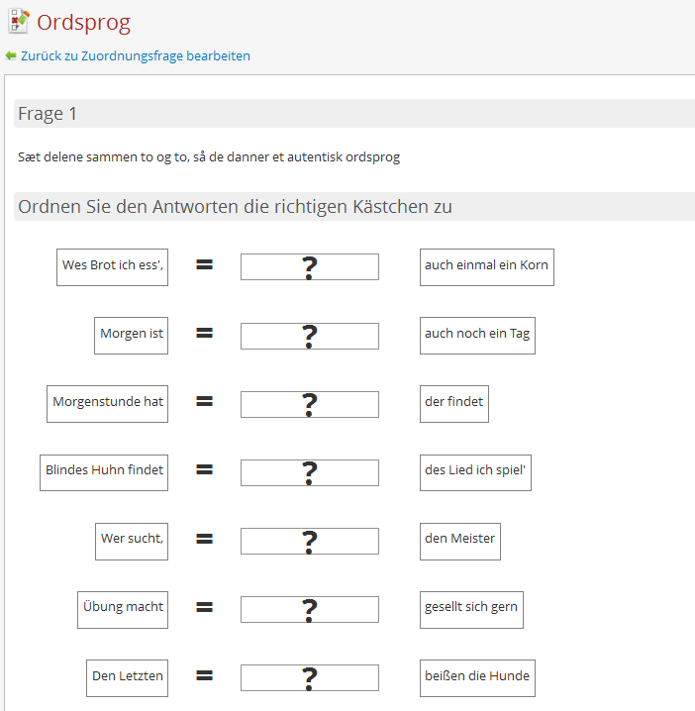
Language proficiency exercises Example: Grammatical and other linguistic exercises with auto-feedback (2)
Description: Put the parts together in pairs to form an authentic saying

Slide 12
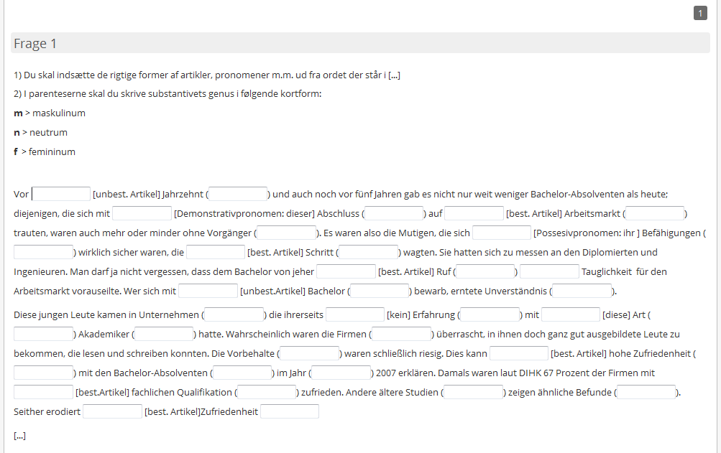
Language proficiency exercises Example: Grammatical and other linguistic exercises with auto-feedback (3)

Slide 13
Weekly quiz with answers
Feedback to media usage and general knowledge
The joy in testing oneself and the delight at competing
Creating a wider overview
Here students and teachers can compete with each other
Students and teachers may take turns at the creating

Slide 14
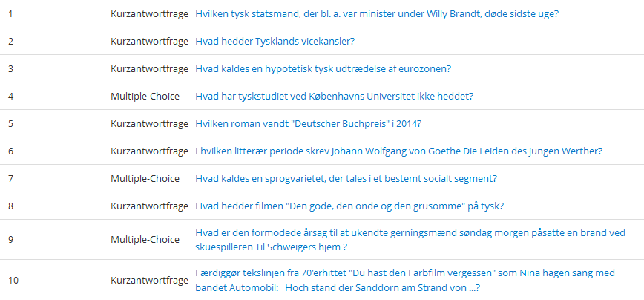
German weekly quiz, an example from week 34

Slide 15
3. Useful links and helpful references to resources.
Media and entertainment
Homepages
Links
Good to know

Slide 16
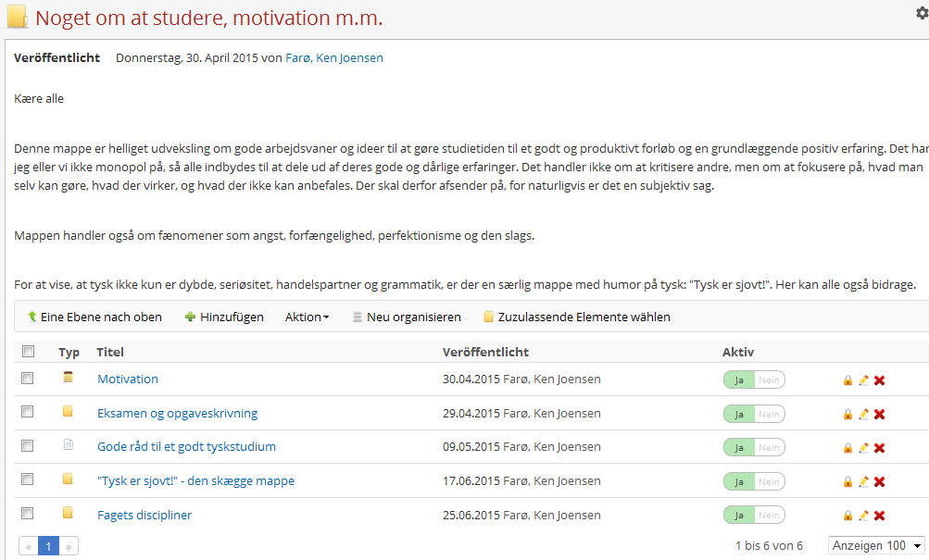
4) About life as a student, motivation, progression etc.

Slide 17
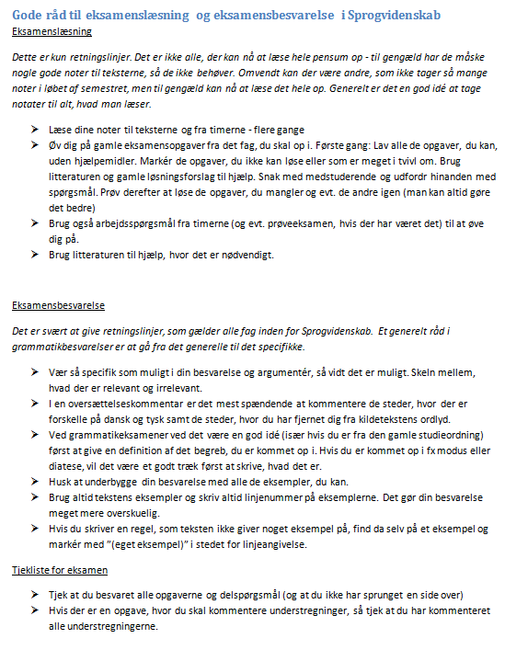
Advice for preparing exams and writing exam papers in Linguistics

Slide 18
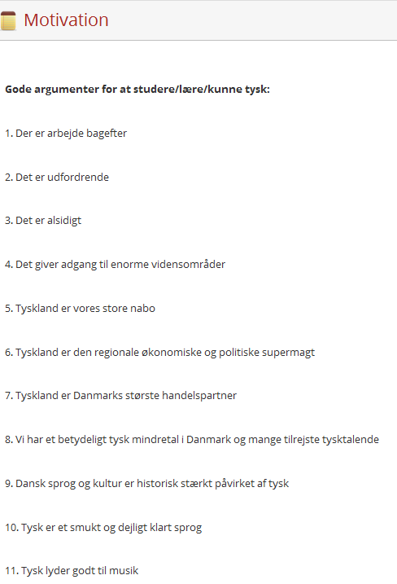
Motivation
Notes:
We have also collected a significant number of arguments for studying German, for keeping up the good spirits, and for being able to defend oneself at dinner conversations.

Slide 19
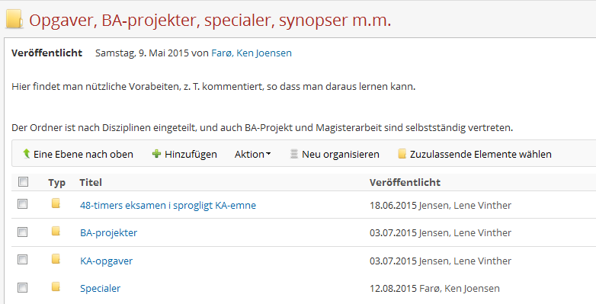
5. Papers, BA projects, master´s theses, synopses, etc.
A dynamic archive
papers, home assignments, translations, master´s theses, (partly commented and with a note) slides from guest lectures (German Friday)

Slide 20
Tables and lists
Terms Danish→German
Abbreviations of German Studies and of the German Department
False friends German-Danish
Typical Dane errors
Typical German mistakes in Danish
Productive literary genres of German Studies

Slide 21
Library and Mediatheque
German DVDs
German board games
German PS2 games for social purposes (eg German quizzes and karaoke)
Podcasts
Articles without copyright problems

